Slide 1
Long Short-Term Memory

Slide 2
Outline
Introduction
Forget Gate
Input Gate
Output Gate

Slide 3
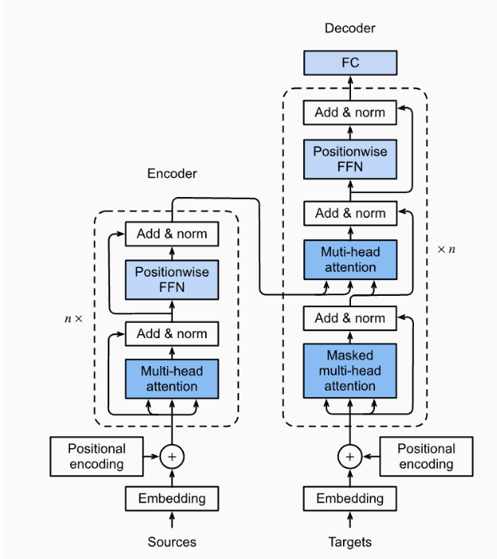
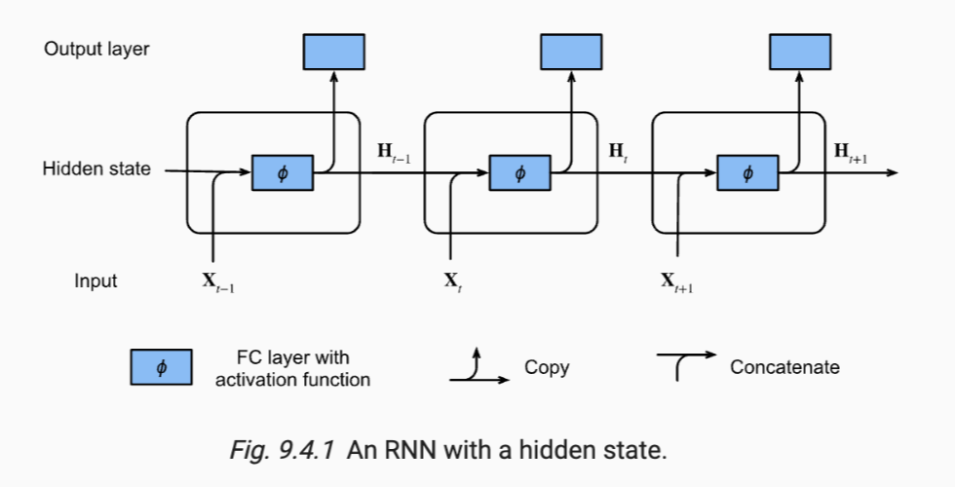
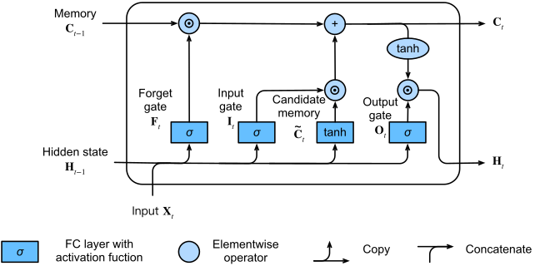
RNN
LSTM
Transformers
Throughout this lesson, we have covered RNNs and now LSTMs, which are stepping stones to learning about Transformers, which is the currently the state-of-the-art architecture.

Slide 4
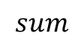

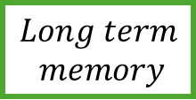

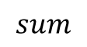





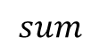


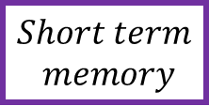
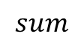
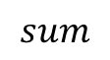
$$Long term$$
$$memory$$
$$×$$
$$sum$$
$$×$$
$$tanh$$
$$σ$$
$$σ$$
$$tanh$$
$$σ$$
$$×$$
$$sum$$
$$sum$$
$$sum$$
$$sum$$
$$Short term$$
$$memory$$
$$Input$$

Slide 5

$$Long term$$
$$memory$$
$$×$$
$$sum$$
$$×$$
$$tanh$$
$$σ$$
$$σ$$
$$tanh$$
$$σ$$
$$×$$
$$sum$$
$$sum$$
$$sum$$
$$sum$$
$$Short term$$
$$memory$$
$$Input$$

Slide 6
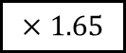

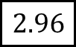
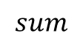

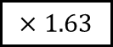
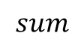
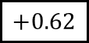
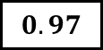


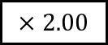
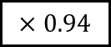
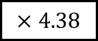
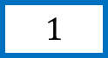
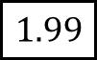
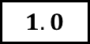

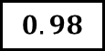
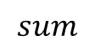
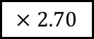

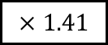
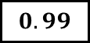
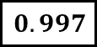

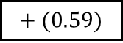


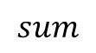
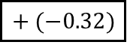
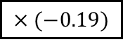
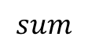
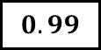
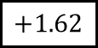

$$2$$
$$×$$
$$1.99$$
$$sum$$
$$2.96$$
$$×$$
$$tanh$$
$$0.997$$
$$1.0$$
$$0.97$$
$$0.99$$
$$σ$$
$$σ$$
$$tanh$$
$$σ$$
$$0.99$$
$$×$$
$$+1.62$$
$$+0.62$$
$$+ (−0.32)$$
$$+ (0.59)$$
$$sum$$
$$sum$$
$$sum$$
$$sum$$
$$0.98$$
$$×2.70$$
$$×2.00$$
$$×1.41$$
$$×4.38$$
$$1$$
$$×1.63$$
$$×1.65$$
$$×0.94$$
$$×(−0.19)$$
$$1$$

Slide 7
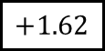

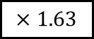
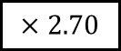



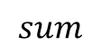
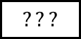


$$2$$
$$×$$
$$???$$
Percentage of long term to remember
$$???$$
$$σ$$
$$+1.62$$
$$sum$$
$$×2.70$$
$$1$$
$$×1.63$$
$$1$$

Slide 8
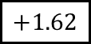
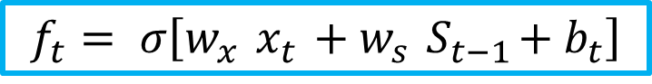

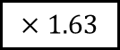
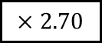



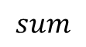
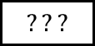


$$2$$
$$×$$
$$???$$
Percentage of long term to remember
$$???$$
$$σ$$
The first stage in a LSTM unit determines what percentage of the Long-Term Memory is remembered.
This is called the Forget Gate
$$+1.62$$
$$sum$$
$$f_{t}= σ\left[w_{x}{ x}_{t} +w_{s}{ S}_{t−1}+b_{t}\right]$$
$$×2.70$$
$$1$$
$$×1.63$$
$$1$$

Slide 9
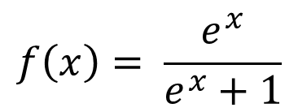
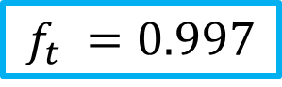
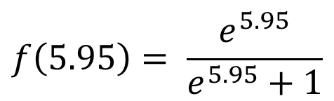

$$2$$
$$×$$
$$???$$
Percentage of long term to remember
$$0.997$$
$$x=(1 ×2.70)+(1 ×1.63)+1.62=5.95$$
$$σ$$
$$f\left(x\right)= \frac{e^{x}}{e^{x}+1}$$
$$+1.62$$
$$f\left(5.95\right)= \frac{e^{5.95}}{e^{5.95}+1}$$
$$sum$$
$$×2.70$$
$$f_{t} =0.997$$
$$1$$
$$×1.63$$
$$1$$

Slide 10




$$2$$
$$×$$
$$1.99$$
We multiply the Long-Term Memory with $f_{t}$
Percentage of long term to remember
$$0.997$$
The Forget Gate’s output $f_{t}$is the percentage of Long-Term Memory to remember.
$$σ$$
$$New Longterm memory= 0.997×2=1.99$$
$$+1.62$$
$$New Longterm memory=1.99$$
$$sum$$
$$×2.70$$
$$1$$
$$×1.63$$
$$1$$

Slide 11


























$$2$$
$$×$$
$$1.99$$
$$sum$$
$$???$$
$$×$$
$$0.997$$
$$???$$
$$???$$
$$σ$$
In a nutshell, this block on the right combines the Short-Term memory and the Input to create a Potential Long-Term Memory.
$$σ$$
$$tanh$$
$$+1.62$$
$$+0.62$$
$$+ (−0.32)$$
$$sum$$
$$sum$$
$$sum$$
$$×2.70$$
$$×2.00$$
$$×1.41$$
$$1$$
$$×1.63$$
$$×1.65$$
$$×0.94$$
Percentage of potential memory
to remember
Potential long term memory
$$1$$

Slide 12
$$2$$
$$×$$
$$1.99$$
$$sum$$
$$???$$
$$×$$
$$0.997$$
$$???$$
$$???$$
$$σ$$
And the block on the left determines what percentage of that Potential Memory to add to the Long-Term Memory.
$$σ$$
$$tanh$$
$$+1.62$$
$$+0.62$$
$$+ (−0.32)$$
$$sum$$
$$sum$$
$$sum$$
$$×2.70$$
$$×2.00$$
$$×1.41$$
$$1$$
$$×1.63$$
$$×1.65$$
$$×0.94$$
Percentage of potential memory
to remember
Potential long term memory
$$1$$

Slide 13





$$2$$
$$×$$
$$1.99$$
$$sum$$
$$???$$
$$×$$
$$0.997$$
$$x=\left(1×1.41\right)+\left(1×0.94\right)+0.32$$
$$???$$
$$0.97$$
$$x=2.03$$
$$σ$$
$$tanh\left(x\right)= \frac{e^{x}−e^{−x}}{e^{x}+e^{−x}}$$
$$σ$$
$$tanh$$
$$+1.62$$
$$+0.62$$
$$+ (−0.32)$$
$$tanh\left(x\right)= \frac{e^{2.03}e^{−2.03}}{e^{2.03}+e^{−2.03}}$$
$$sum$$
$$sum$$
$$sum$$
$$×2.70$$
$$×2.00$$
$$×1.41$$
$$i_{t} =0.97$$
$$1$$
$$×1.63$$
$$×1.65$$
$$×0.94$$
Percentage of potential memory
to remember
Potential long term memory
$$1$$

Slide 14
$$2$$
$$×$$
$$1.99$$
$$sum$$
$$???$$
$$×$$
$$0.997$$
$$???$$
$$0.97$$
$$σ$$
Now the LSTM has to decide how much of this Potential Long-Term Memory to save…
$$σ$$
$$tanh$$
$$+1.62$$
$$+0.62$$
$$+ (−0.32)$$
$$sum$$
$$sum$$
$$sum$$
$$×2.70$$
$$×2.00$$
$$×1.41$$
$$1$$
$$×1.63$$
$$×1.65$$
$$×0.94$$
Percentage of potential memory
to remember
Potential long term memory
$$1$$

Slide 15
$$2$$
$$×$$
$$1.99$$
$$sum$$
$$???$$
$$×$$
$$0.997$$
$$???$$
$$0.97$$
$$σ$$
This is done using the exact same method we used earlier, when we determined what percentage of the Long-Term Memory to remember
$$σ$$
$$tanh$$
$$+1.62$$
$$+0.62$$
$$+ (−0.32)$$
$$sum$$
$$sum$$
$$sum$$
$$×2.70$$
$$×2.00$$
$$×1.41$$
$$1$$
$$×1.63$$
$$×1.65$$
$$×0.94$$
Percentage of potential memory
to remember
Potential long term memory
$$1$$

Slide 16






$$2$$
$$×$$
$$1.99$$
$$sum$$
$$???$$
$$×$$
$$0.997$$
$$x=(1 ×2.00)+(1 ×1.65)+0.62$$
$$1$$
$$0.97$$
$$σ$$
$$x=4.27$$
$$σ$$
$$tanh$$
$$f\left(x\right)= \frac{e^{x}}{e^{x}+1}$$
$$+1.62$$
$$+0.62$$
$$+ (−0.32)$$
$$f\left(4.27\right)= \frac{e^{4.27}}{e^{4.27}+1}$$
$$sum$$
$$sum$$
$$sum$$
$$×2.70$$
$$×2.00$$
$$×1.41$$
$$f_{t} =1$$
$$1$$
$$×1.63$$
$$×1.65$$
$$×0.94$$
Percentage of potential memory
to remember
Potential long term memory
$$1$$

Slide 17

$$2$$
$$×$$
$$1.99$$
$$sum$$
$$???$$
$$×$$
$$0.997$$
$$1$$
$$0.97$$
$$σ$$
This part of the LSTM unit determines how we should update the Long-Term memory
This is called the Input Gate
$$σ$$
$$tanh$$
$$+1.62$$
$$+0.62$$
$$+ (−0.32)$$
$$sum$$
$$sum$$
$$sum$$
$$×2.70$$
$$×2.00$$
$$×1.41$$
$$i_{t}= σ\left[w_{x}{ x}_{t} +w_{s}{ s}_{t−1}+b_{t}\right]$$
$$1$$
$$×1.63$$
$$×1.65$$
$$×0.94$$
Percentage of potential memory
to remember
Potential long term memory
$$1$$

Slide 18


$$2$$
$$×$$
$$1.99$$
$$sum$$
$$2.96$$
$$×$$
$$0.997$$
$$1$$
$$0.97$$
$$σ$$
We now add 0.97 to the existing Long-Term Memory
And we get a new Long-Term Memory, 2.96
$$σ$$
$$tanh$$
$$+1.62$$
$$+0.62$$
$$+ (−0.32)$$
$$sum$$
$$sum$$
$$sum$$
$$×2.70$$
$$×2.00$$
$$×1.41$$
$New Longterm memory=0.97+1.99$ = 2.96
$$1$$
$$×1.63$$
$$×1.65$$
$$×0.94$$
Percentage of potential memory
to remember
Potential long term memory
$$1$$

Slide 19


























$$2$$
$$×$$
$$1.99$$
$$sum$$
$$2.96$$
$$×$$
$$0.997$$
$$1.0$$
$$0.97$$
$$σ$$
$$σ$$
$$tanh$$
$$+1.62$$
$$+0.62$$
$$+ (−0.32)$$
$$sum$$
$$sum$$
$$sum$$
$$×2.70$$
$$×2.00$$
$$×1.41$$
$$1$$
$$×1.63$$
$$×1.65$$
$$×0.94$$
$$1$$

Slide 20


























$$2$$
$$×$$
$$1.99$$
$$sum$$
$$2.96$$
$$×$$
$$0.997$$
$$1.0$$
$$0.97$$
$$σ$$
$$σ$$
$$tanh$$
$$+1.62$$
$$+0.62$$
$$+ (−0.32)$$
$$sum$$
$$sum$$
$$sum$$
$$×2.70$$
$$×2.00$$
$$×1.41$$
$$1$$
$$×1.63$$
$$×1.65$$
$$×0.94$$
$$1$$

Slide 21




































$$2$$
$$×$$
$$1.99$$
$$sum$$
$$2.96$$
$$×$$
$$0.997$$
$$tanh$$
$$1.0$$
$$0.97$$
$$???$$
$$σ$$
$$σ$$
$$tanh$$
$$σ$$
$$???$$
$$×$$
$$+1.62$$
$$+0.62$$
$$+ (−0.32)$$
$$+ (0.59)$$
$$sum$$
$$sum$$
$$sum$$
$$sum$$
$$0.98$$
$$×2.70$$
$$×2.00$$
$$×1.41$$
$$×4.38$$
$$1$$
$$×1.63$$
$$×1.65$$
$$×0.94$$
$$×(−0.19)$$
$$1$$
Percentage of potential memory
to remember
Potential short-term memory

Slide 22

















$$2$$
$$×$$
$$1.99$$
$$sum$$
$$2.96$$
The final stages of the LSTM updates Short-Term Memory
$$tanh$$
$$???$$
$$σ$$
$$???$$
$$×$$
$$+ (0.59)$$
$$sum$$
$$0.98$$
New Short term Memory
$$×4.38$$
$$1$$
$$×(−0.19)$$
$$1$$
Percentage of potential memory
to remember
Potential short-term memory

Slide 23



$$2$$
$$×$$
$$1.99$$
$$sum$$
$$2.96$$
We start with the New Long Term Memory and use it as input to the Tanh Activation function
$$tanh$$
$$0.99$$
$$tanh\left(x\right)= \frac{e^{x}−e^{−x}}{e^{x}+e^{−x}}$$
$$σ$$
$$???$$
$$×$$
$$+ (0.59)$$
$$tanh\left(2.96\right)= \frac{e^{2.96}e^{−2.96}}{e^{2.96}+e^{−2.96}}=0.99$$
$$sum$$
$$0.98$$
New Short term Memory
$$×4.38$$
$$1$$
$$×(−0.19)$$
$$1$$
Percentage of potential memory
to remember
Potential short-term memory

Slide 24



$$2$$
$$×$$
$$1.99$$
$$sum$$
$$2.96$$
We use the exact same method again to get the percentage of potential memory to remember
$$tanh$$
$$0.99$$
$$x=(1 ×−0.19)+(1 ×4.38)+0.59=4.78$$
$$σ$$
$$???$$
$$×$$
$$f\left(x\right)= \frac{e^{x}}{e^{x}+1}$$
$$+ (0.59)$$
$$f\left(4.78\right)= \frac{e^{4.78}}{e^{4.78}+1}$$
$$sum$$
$$0.98$$
New Short term Memory
$$f_{t} =0.99$$
$$×4.38$$
$$1$$
$$×(−0.19)$$
$$1$$
Percentage of potential memory
to remember
Potential short-term memory

Slide 25


$$2$$
$$×$$
$$1.99$$
$$sum$$
$$2.96$$
We now create the New Short Term Memory by multiplying 0.99 by 0.99
$$tanh$$
$$0.99$$
$$New Short Term Memory=0.99×0.99$$
$$σ$$
$$0.99$$
$$×$$
$$New Short Term Memory=0.98$$
$$+ (0.59)$$
$$sum$$
$$0.98$$
New Short term Memory
$$×4.38$$
$$1$$
$$×(−0.19)$$
$$1$$
Percentage of potential memory
to remember
Potential short-term memory

Slide 26

$$2$$
$$×$$
$$1.99$$
$$sum$$
$$2.96$$
Because the New Short Term-Memory is the output of this entire LSTM unit
This is called the Output Gate
$$O_{t}= σ\left[W_{x}{ X}_{t} +W_{s}{ S}_{t−1}+b_{t}\right]$$
$$S_{t}= O_{t} tanh\left[C_{t}\right]$$
$$tanh$$
$$0.99$$
$$σ$$
$$0.99$$
$$×$$
$$+ (0.59)$$
$$sum$$
$$0.98$$
New Short term Memory
$$×4.38$$
$$1$$
$$×(−0.19)$$
$$1$$
Percentage of potential memory
to remember
Potential short-term memory

Slide 27




































$$2$$
$$×$$
$$1.99$$
$$sum$$
$$2.96$$
$$×$$
$$0.997$$
$$tanh$$
$$1.0$$
$$0.97$$
$$0.99$$
$$σ$$
$$σ$$
$$tanh$$
$$σ$$
$$0.99$$
$$×$$
$$+1.62$$
$$+0.62$$
$$+ (−0.32)$$
$$+ (0.59)$$
$$sum$$
$$sum$$
$$sum$$
$$sum$$
$$0.98$$
$$×2.70$$
$$×2.00$$
$$×1.41$$
$$×4.38$$
$$1$$
$$×1.63$$
$$×1.65$$
$$×0.94$$
$$×(−0.19)$$
$$1$$

Slide 28




































$$2$$
$$×$$
$$1.99$$
$$sum$$
$$2.96$$
$$×$$
$$tanh$$
$$0.997$$
$$1.0$$
$$0.97$$
$$0.99$$
$$σ$$
$$σ$$
$$tanh$$
$$σ$$
$$0.99$$
$$×$$
$$+1.62$$
$$+0.62$$
$$+ (−0.32)$$
$$+ (0.59)$$
$$sum$$
$$sum$$
$$sum$$
$$sum$$
$$0.98$$
$$×2.70$$
$$×2.00$$
$$×1.41$$
$$×4.38$$
$$1$$
$$×1.63$$
$$×1.65$$
$$×0.94$$
$$×(−0.19)$$
$$1$$

Slide 29







$$0$$
$$×$$
$$sum$$
$$×$$
$$tanh$$
$$σ$$
$$σ$$
$$tanh$$
$$σ$$
$$×$$
$$sum$$
$$sum$$
$$sum$$
$$sum$$
$$0$$
$$1$$

Slide 30
$$Long term$$
$$memory$$
$$×$$
$$sum$$
$$×$$
$$tanh$$
$$σ$$
$$σ$$
$$tanh$$
$$σ$$
$$×$$
$$sum$$
$$sum$$
$$sum$$
$$sum$$
$$Short term$$
$$memory$$
$$Input$$

Slide 31
Price
Day
For demonstration, let us sequentially run the data from day 1 to 4 through an unrolled LSTM and see if it can correctly predict the values for day 5 for both companies

Slide 32




Price
Day

Slide 33




Price
Day

